Slide 1


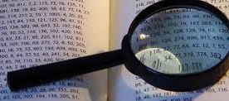




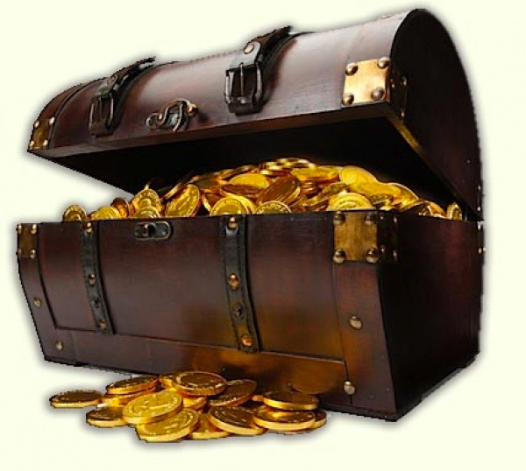

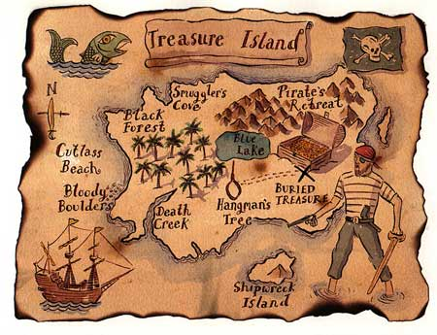
How to discover contribution item ?
Happy hacking !
Gyuyoung Kim

Slide 2

Who is Gyuyoung Kim ?
Happy hacking !
Join to Samsung Electronics in 2005
Start to contribute a little patches to Mozilla SpiderMonkey in 2008
Start to contribute to WebKit in 2009
Became a WebKit committer in Oct. 2010
Became a WebKit Reviewer in Aug. 2012
Became a Chromium/Blink committer in Mar. 2014
What is next ??

Slide 3
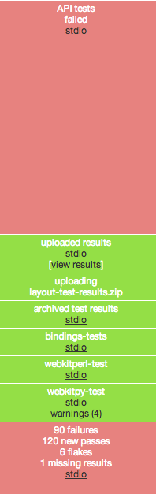
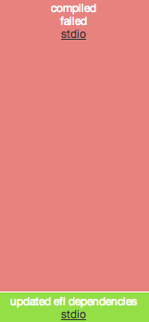
Start to fix easy thing
Fix a build error/warning during the compilation
Open source build may be often broken :(
Maintain regression or unit test
Layout test gardening, WebKit API unit test, etc
Apply famous C/C++ technique to your open source
explicit keyword, std::unique_ptr, etc.
webkit efl buildbot

Slide 4
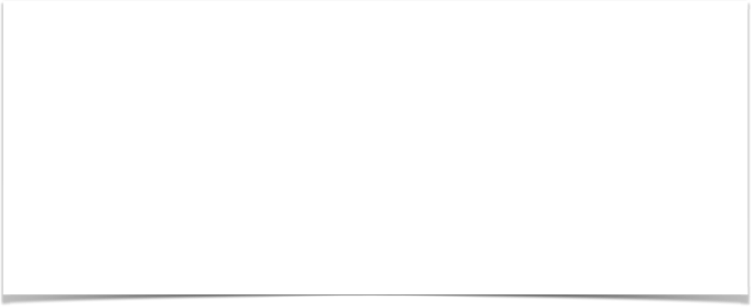
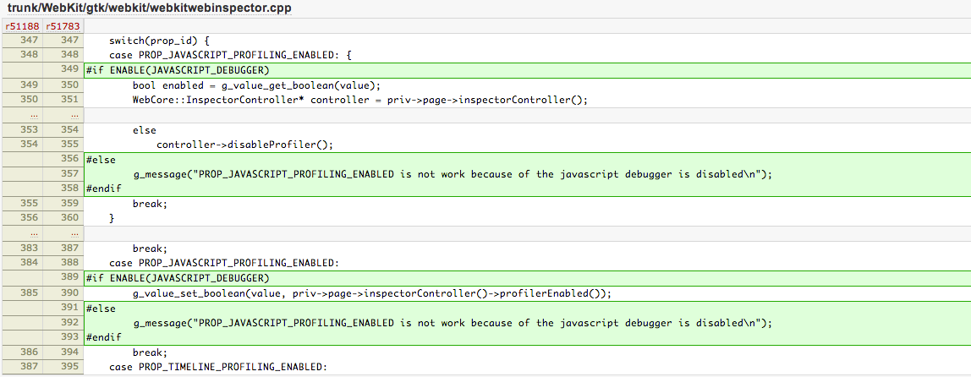
Start to fix easy thing (Cont.)
For instance, what is my first webkit patch ?
[GTK] WebKit does not compile without JAVASCRIPT_DEBUGGER
- Fix build errors when javascript-debugger is disabled on GTK
(http://trac.webkit.org/changeset/51783)

Slide 5
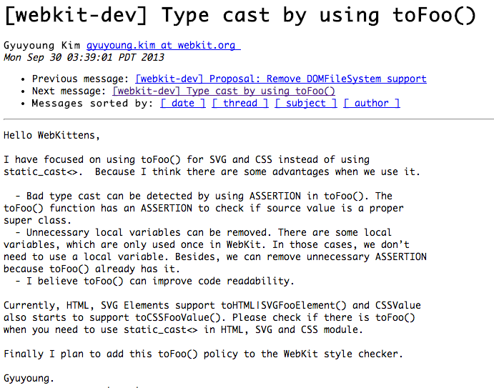
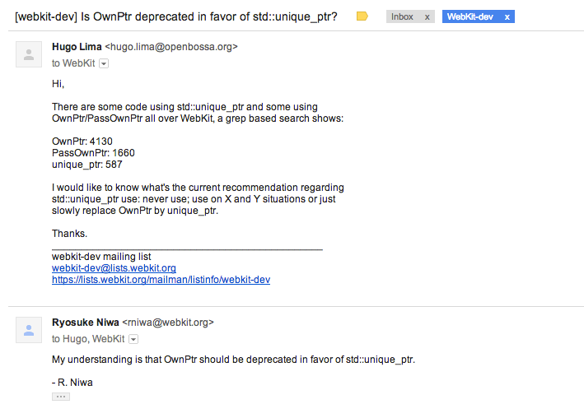
Monitor mailing list
You can know plan or direction what your open source wants to do

Slide 6
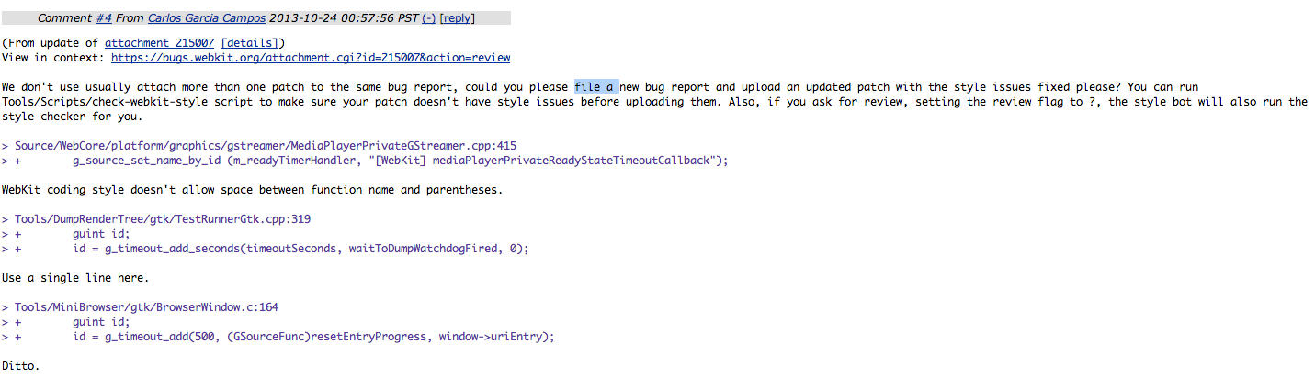
Do not forget reviewer comment
Reviewer often gives a hint regarding new contribution item during the code review

Slide 7
Watch active contributor
Read his/her latest patch
WebKit : Ryosuke Niwa, Andreas Kling, Simon Fraser, Zan Dobersek, Dave Hyatt, etc
Blink : Adam Barth, Tamura Kent, Nill Barth, Kentaro Hara, Jochen Eisinger, Hajime Morrita, etc.
Become a friend with him or her
You may collaborate with the active contributor

Slide 8


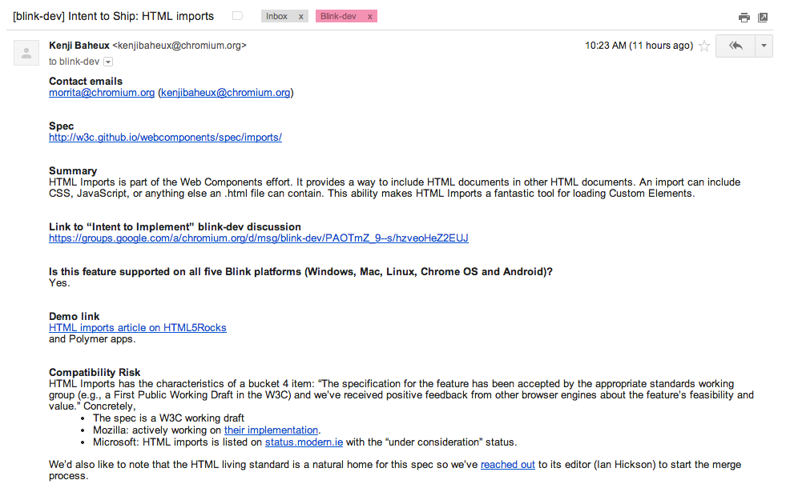


Become a first contributor for new spec.

Slide 9
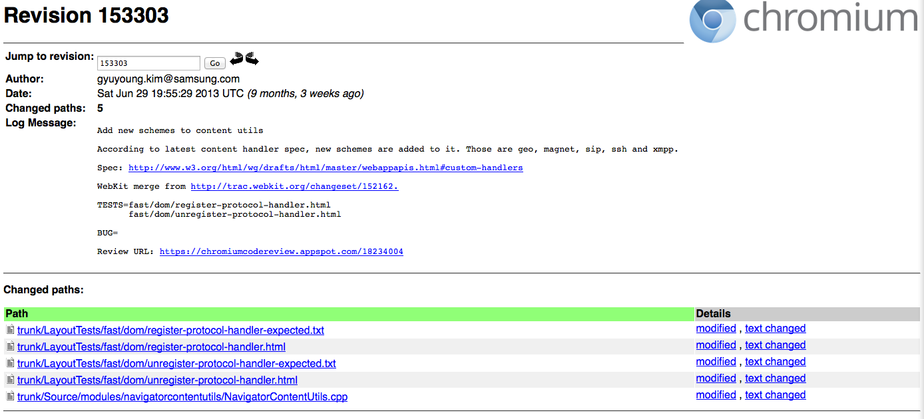
Become a first contributor for new spec. (Cont.)
For instance, if a specification is updated, we can apply the changes to open source

Slide 10
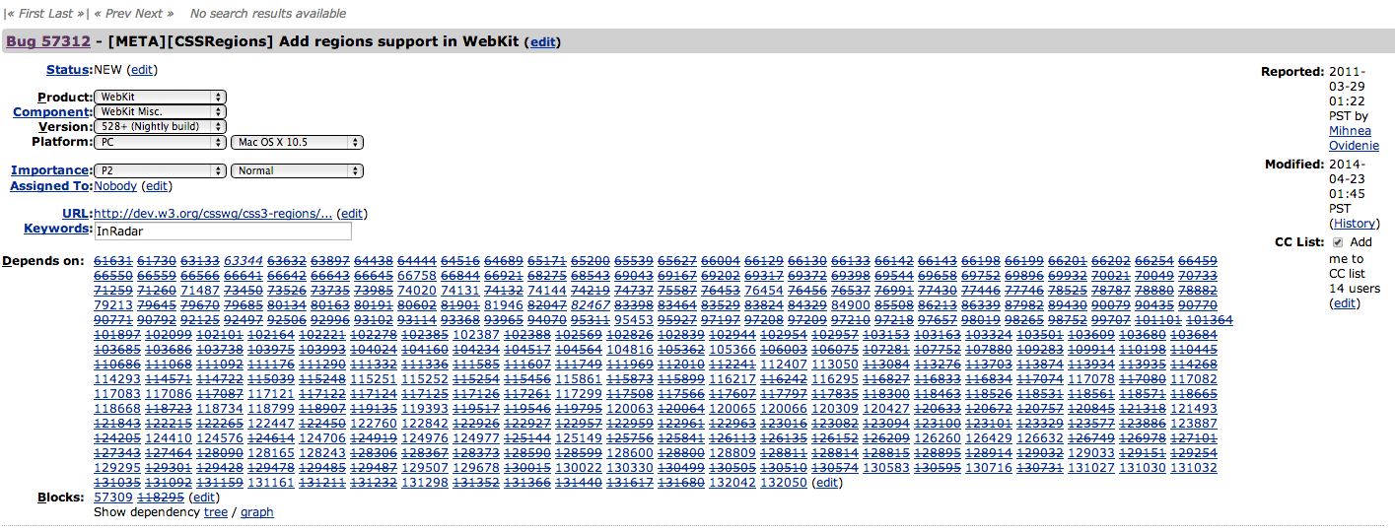
Participated in Meta bug
Meta bug is to gather related to bugs, WebKit usually file a meta bug when issue can’t be solved by a patch
https://bugs.webkit.org/show_bug.cgi?id=57312

Slide 11
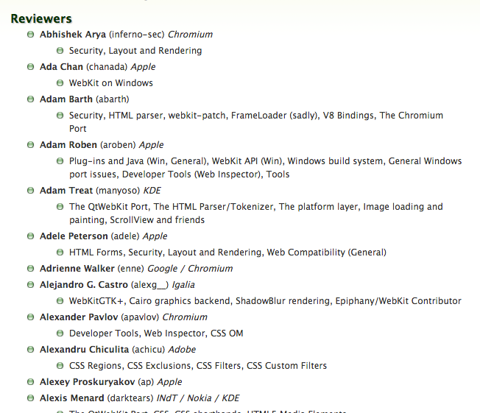

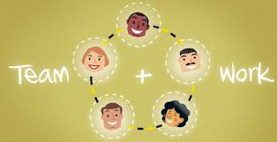
Concentrate on a module
A few talented maintainers can’t cover all modules
Important to be recognised as an expert for specific module or feature
e.g) WebKit reviewer, Chromium owner
Open source is team work

Slide 12
Appendix - 1
What skill do you need to contribute ?

Slide 13
English is always important
Don’t stop to speak English
See US drama or movie with English caption
Steady phone English
Have a dinner party with foreigner visitor
Have foreigner friends
List up impressive review comments
Make own idiom note that you have used in contribution or review

Slide 14
English is always important (Cont.)
My note which summarise idioms mentioned in WebKit code review
As a step to let ewk be compliant with webkit coding style
Anybody free for review ?
The API(or patch) needs some love
It would be good if you said XXXXX or it would be good to add a comment explaining why this is being done
This is the way to go
Since nobody tells me about the next and future
Sound great !!
I dislike that people review these things without good explanation and without knowledge of the area
Looks like there are enough concerns to r
I'd like to apologise ahead of time for the inconvenience

Slide 15
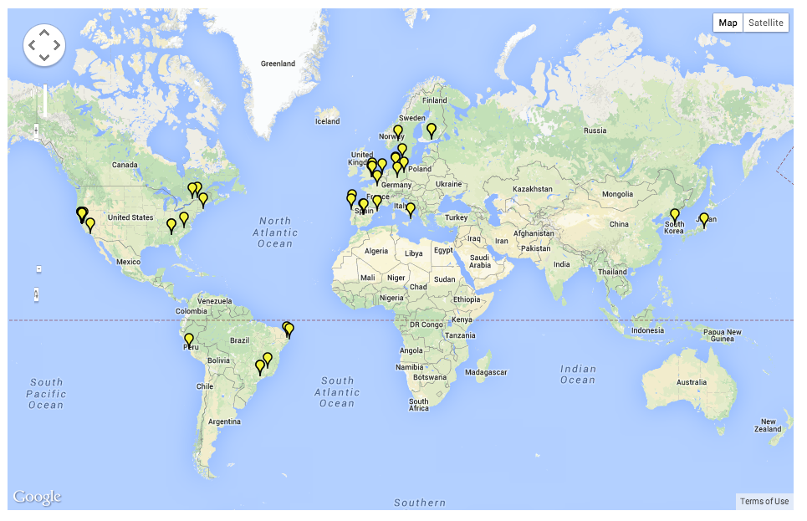
Reply to question ASAP !
Time gap can sometimes become a problem when you want to get review from other continent’s reviewer
To land your patch ASAP, you need to try to reply to comment or question
WebKit Contributor Location

Slide 16
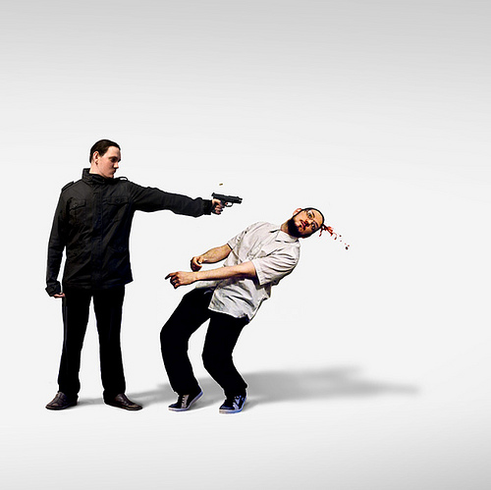
Don’t be afraid of talking with foreigner
Most serious problem to Korean developer
Reviewer/Committer NEVER kill you even if you upload stupid patch !
Don’t be afraid of getting r-
Code review doesn't prohibit to land your patch, but help to land your patch !

Slide 17
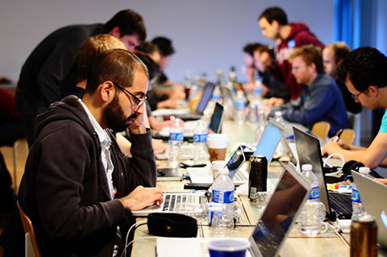
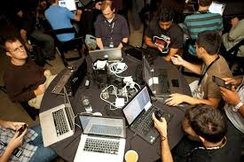
Be familiar with your laptop
Open source developer needs be connected to community constantly
Some Korean developers have *only* Windows PC, even a little developers among them don’t have any PC or laptop at home

Slide 18
Appendix - 2
Demo - how to land a patch to WebKit trunk

Slide 19
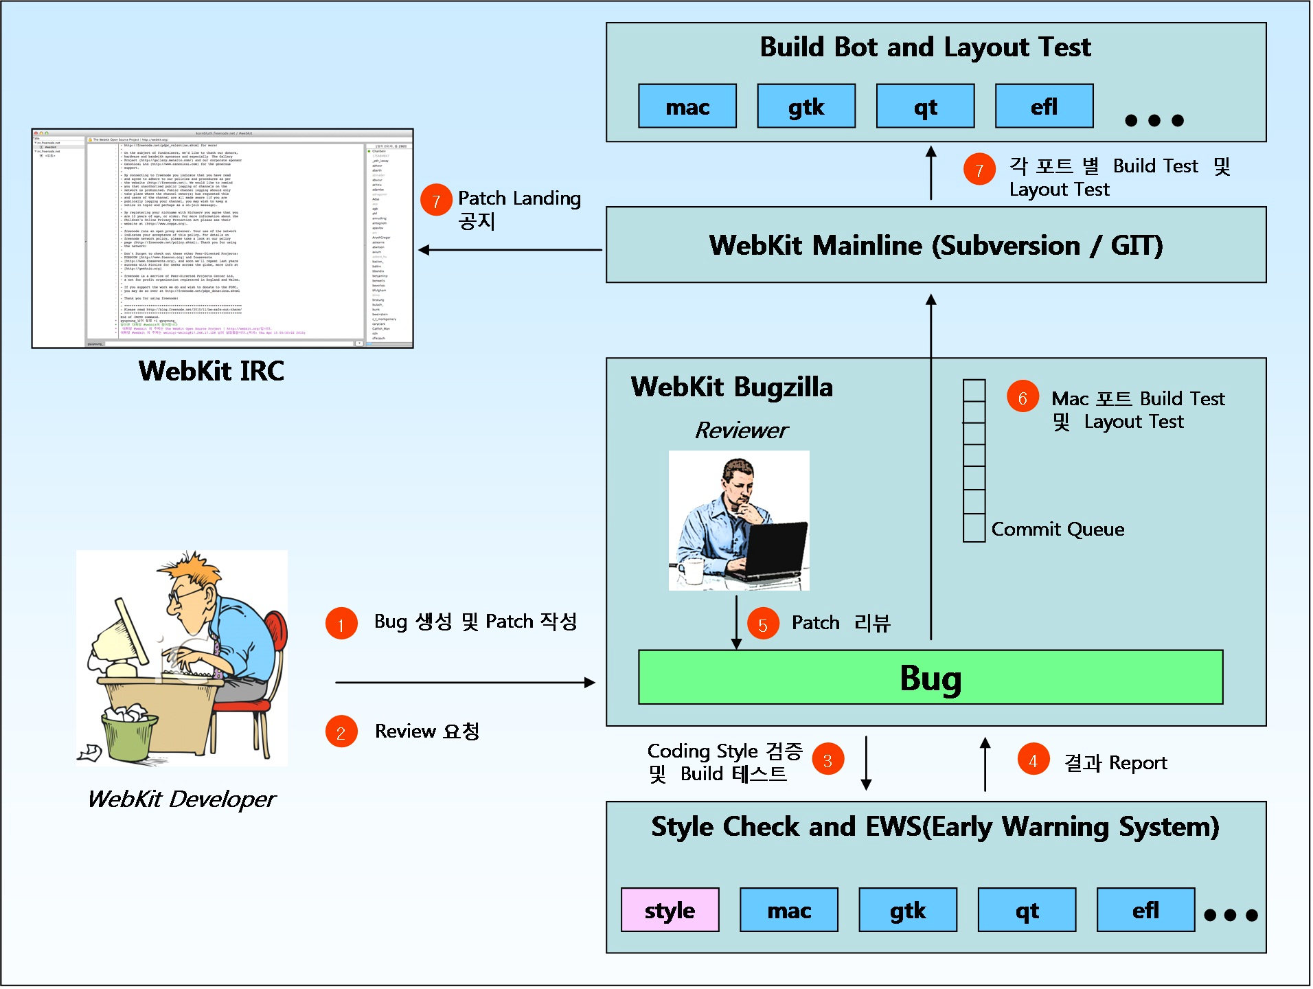
How to land a patch to WebKit trunk ?

Slide 20
Demo

